Slide 1
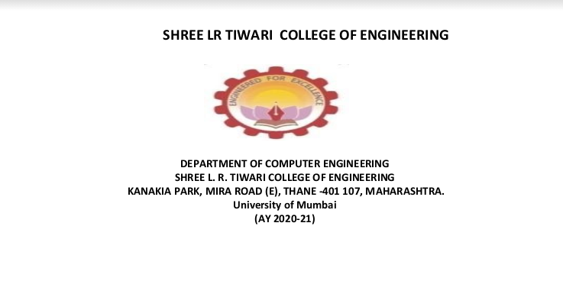
Group Unique ID: AY21TECSM50115
Group Members :- 56_Singh_Pooruvi (Leader)
27_Kini_Aditya
32_Maurya_Suraj
59_Tendolkar_Omkar
Guide:- Neelam Kulkarni

Slide 2
Car and House price prediction web application

Slide 3
Table Of Content
01
02
03
04
05
06
07
08
09
10
11
12
13
Introduction
Problem statement
Motivation
Objective
Literature Review
Proposed System
Requirements
Feasibility Study
Scope of the project
Limitation
Application
Block Diagram
Use case diagram

Slide 4
Table Of Content
Sequence Diagram
Activity Diagram
Car Price Prediction Model
House Price Prediction Model
PERT chart
Conclusion
References
Thankyou
14
15
16
17
18
19
20
21
22

Slide 5
INTRODUCTION
Car and House are one of the most important possessions for humans
A car confers prestige, self control and autonomy
A House provides a sense of security and well being a symbol of power and authority
In this Project we have made a comparative study of Linear and Lasso regression for car price prediction model and a comparative study of Linear and Ridge regression for house price prediction model.
Determination of prices of Housing property and used car still involves lack of transparency and people are not assured of the prices that they are paying for the housing property or used cars. Hence there is a need of a system that can help in predicting prices of used car and housing properties.

Slide 6
Problem Statement
To Develop Machine Learning model that predicts the resale value of used cars on the basis of various factors like Name, Company, Year, Kilometers driven, Fuel-type and value of housing properties on the basis of factors like Area, Location, No of bedroom, New or resale.

Slide 7
MOTIVATION
Bring Transparency to the consumer
To cut the intermediary cost
To decide whether a used car is worth the posted price
To regulate the reselling-item system.

Slide 8
Objectives
To develop a web application that helps users to predict the value of the used cars and housing properties.
To help car dealers better understand what makes a car desirable , it’s important feature in order to provide better services.
To predict the efficient house pricing for real estate customers by considering number of factors.
To develop the frontend
To develop an interactive client-side interface with the help of technologies like HTML, CSS and JavaScript so that user can see and interact directly
To develop backend
It will help to deploy and integrate our machine learning model with the help of technology like Flask.

Slide 9
Literature Review
Reference Paper | Authors | Journal / Conference and year | Algorithm and Tool used | Observations and Results
Prediction of Prices for Used Car by Using Regression Models | Nitis Monburinon, Prajak Chertchom Thongchai Kaewkiriya, Suwat Rungpheung, Sabir Buya, Pitchayakit Boonpou . | 2018 5th International Conference on Business and Industrial Research (ICBIR), Bangkok, Thailand | Gradient Boosted regression tree, Random forest,multiple linear regression | Gradient boosted regression trees gave the highest performance with only MAE =0.28. Followed by random forest regression with 0.35 errors, and multiple linear regression with 0.55 errors.
Used Cars Price Prediction using Supervised Learning Techniques | Pattabiraman Venkatasubbu, Mukkesh Ganesh | International Journal of Engineering and Advanced Technology (IJEAT) ISSN: 2249 – 8958, Volume-9 Issue-1S3, December 2019 | Lasso regression,Multiple regression,Regression tree | The prediction error rate of all the models was well under the accepted 5% of error. But,the mean error of the regression tree model was found to be more than the mean error rate of the multiple regression and lasso regression models.
Used Car Price Prediction using K-Nearest Neighbor Based Model | K.Samruddhi, Dr R.Ashok Kumar | International Journal of Innovative Research in Applied Sciences and Engineering (IJIRASE) Volume 4, Issue 2, August 2020 | K nearest neighbour algorithm | It has 85% accuracy, Root-Mean Squared Error (RMSE) rate of 4.01 and Means Absolute Error (MAE) rate of 2.01 with K value of 4.

Slide 10
Literature Review
Reference Paper | Authors | Journal / Conference and year | Algorithm and Tool used | Observations and Results
House Resale Price Prediction Using Classification Algorithms | P. Durganjali, M. Vani Pujitha | IEEE 6th International Conference on smart structures and systems ICSSS 2019. | . In this paper, the resale price prediction of the house is done using different classification algorithms like Logistic regression, Decision tree, Naive Bayes and Random forest are used . AdaBoost algorithm for boosting up the weak learners to strong learners. | The accuracy of logistic regression is 81.4 %and accuracy of decision tree is highest that is 92 %
House Price Prediction Using Regression Techniques: A Comparative Study | CH.Raga Madhuri, Anuradha G, M.Vani Pujitha | IEEE 6th International Conference on smart structures and systems ICSSS 2019. | The paper involves predictions using different Regression techniques like Multiple linear, Ridge, LASSO, Elastic Net, Gradient boosting and AdaBoost Regression. | This article mainly concentrates on the comparison between different machine learning algorithms and among all algorithms gradient boosting has high accuracy value Here the [MSE] Mean Square Error and [RMSE] Root Mean Square Error are used in in order to calculate the accuracy value of the algorithm. It has a score of 0.9177022, MSE of 12037006088.27804,RMSE of 109713 90390
HOUSE PRICE FORECASTING USING MACHINE LEARNING | ALISHA KUVALEKAR, SHIVANI MANCHEWAR, SIDHIKA MAHADIK, SHILA JAWALE | Proceedings of the 3rd International Conference on Advances in Science & Technology (ICAST) 2020 | Decision tree regressor | The accuracy of the model obtained was 89%

Slide 11
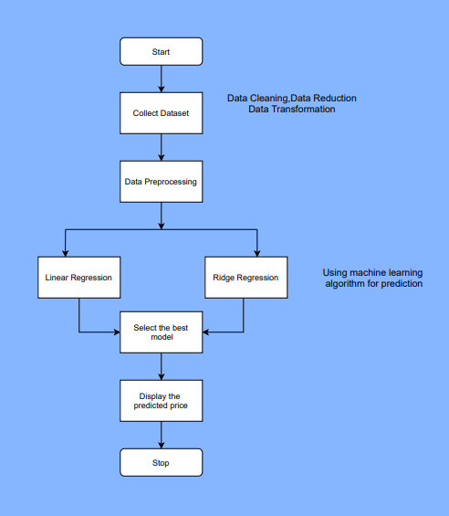
Proposed System
House Prediction

Slide 12
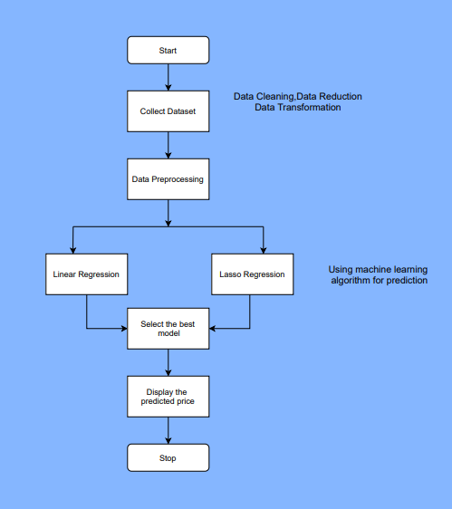
Proposed System
Car Prediction

Slide 13
Requirements
Hardware
User End:
Any android or IOS smartphone ,tablets PCs or Desktop
Developer End:
The Minimum system requirement
Operating System: Windows 8 or later 64-bit Ubuntu 14.04+, Debian 8+, openSUSE 13.3+, or Fedora Linux 24+
Processor: Intel Pentium 4 or later
Memory:2 GB minimum 4GB recommended
Screen resolution:1280x1024 or larger
Software
Frontend technologies:
HTML CSS
Bootstrap
Backend Technologies:
Flask
JavaScript
Jupiter Notebook

Slide 14
Feasibility Study
Financial Feasibility : As it is a Web Application this system does not require any amount of financial investment . The financial requirements would be for the following :
Domain name .
Hosting .
AWS cloud storage .
Technical Feasibility : House and car price prediction is a complete web application build using ML , HTML , CSS , JS ,JS Node and many more . All the apis are properly functional and the response time is less than 2 seconds . maximum features related to this feature are achieved using these technologies.
Resources Feasibility : Resources that are required for the house and car price prediction project includes programing device(laptop), Hosting space (freely available) , programming tools(free available).

Slide 15
Feasibility Study
Time Feasibility : Project developed plan Prepaired according to availability of number of week and hours/week in the bi-semester.
Social Feasibility : No commission charges excepts the taxes, maintenance , and the other cost required for the website
Risk Feasibility : As it is an web based application there is an risk of corrupting and interferance of the virus which may slow down the web application and crash the hosting .

Slide 16
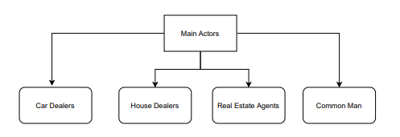
Scope Of The Project
Main cases associated :
Real estate agents : Evaluation of their properties
Car dealers : Evaluation of their cars
Common man : Evaluation of their car and house

Slide 17
LIMITATIONS
In order to have more robust prediction there is need to gather more data over period of time and there could be more features that can be good predictor for car price prediction like number of doors, color, mechanical and cosmetic reconditioning time.

Slide 18
Application
Social:
The Model will Eliminate the need of intermediaries determining the price and people will be assured of the price they are paying or getting for their property or cars.
Commercial:
The model can be used by various organizations and ventures that provides services like buying and selling to customers in a whole new revolutionized way.
Industrial:
This will help automobile industries to manipulate the design of the cars, the business strategy etc. to meet certain price levels. It will help budding automobile industries to enter into market and understand various factors affecting the automobile price.

Slide 19
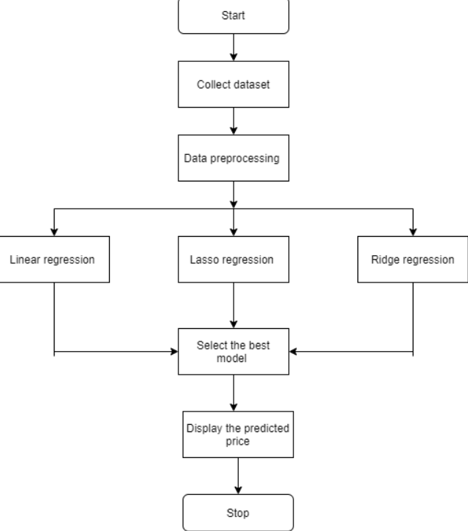
Block Diagram

Slide 20
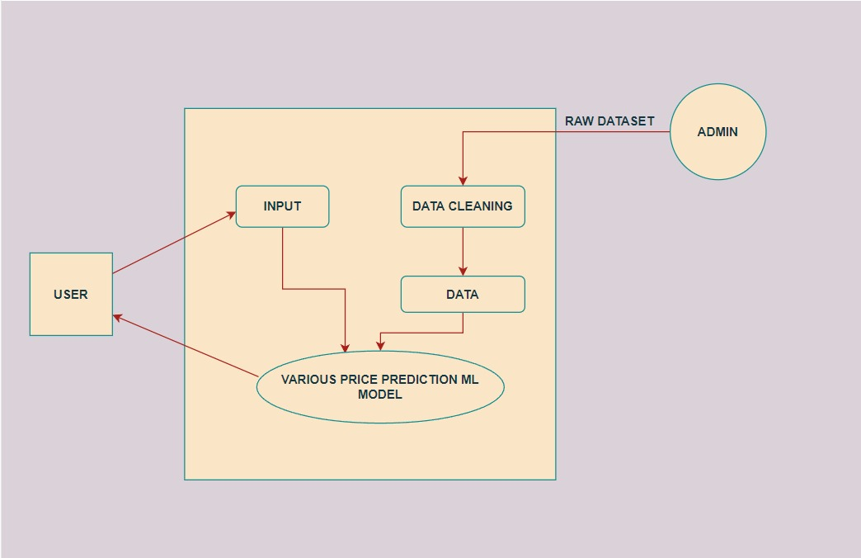
Use Case Diagram

Slide 21
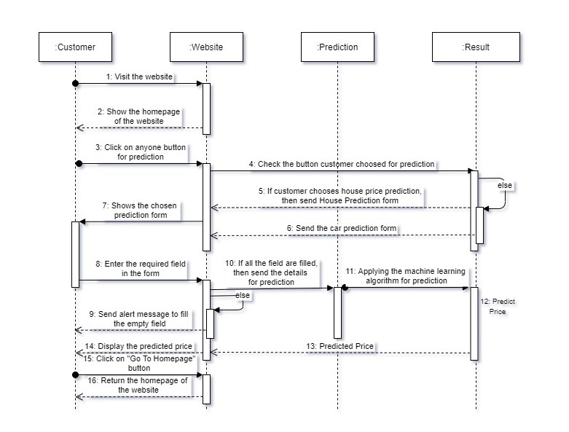
Sequence Diagram

Slide 22
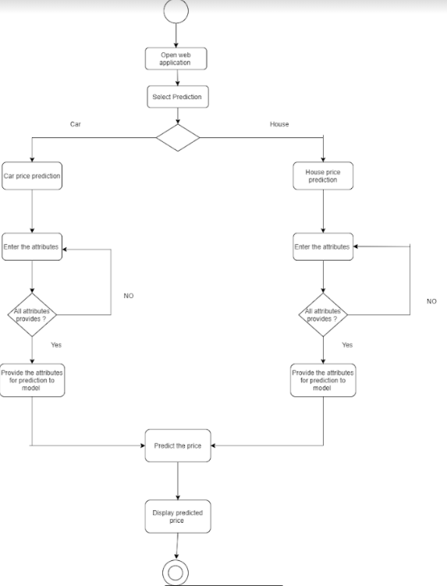
Activity Diagram

Slide 23
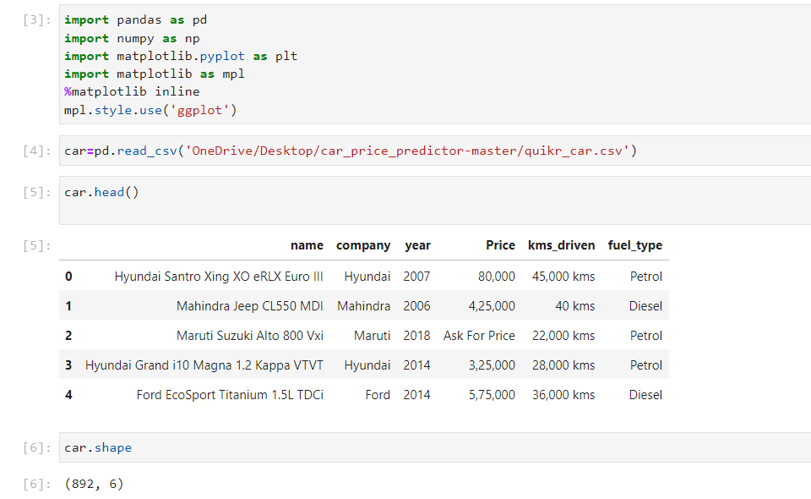
Car Price Prediction Model
Importing dependencies and checking the quality of data
Initially we are having 892 records

Slide 24
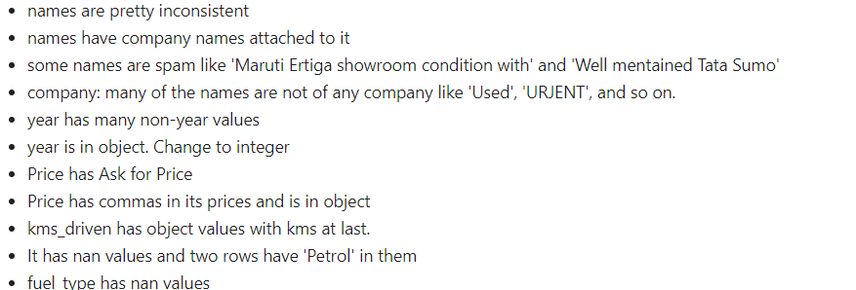
Car Price Prediction Model
Quality Of Data
Following are the anomalies observed in data

Slide 25
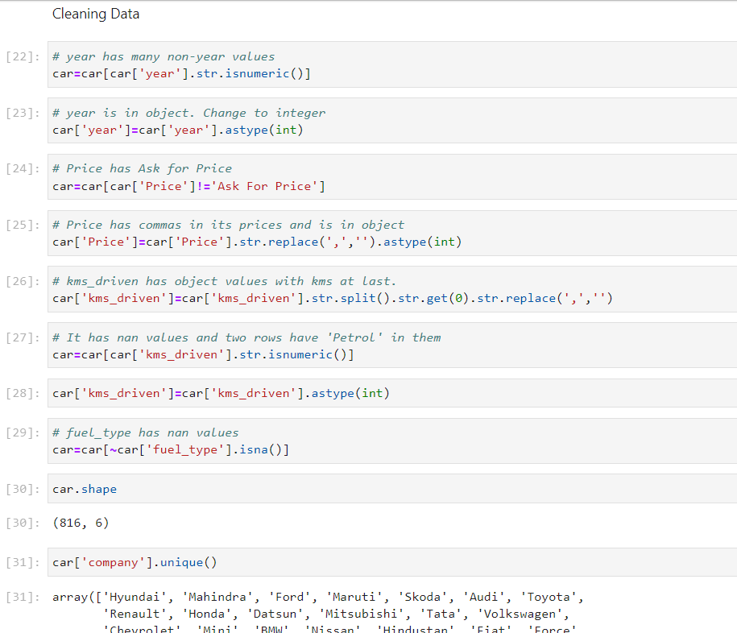
Car Price Prediction Model
Cleaning Data
Functions Like isnumeric(), astype(), str.replace(), isna() will help us dealing with the anomalies in dataset

Slide 26
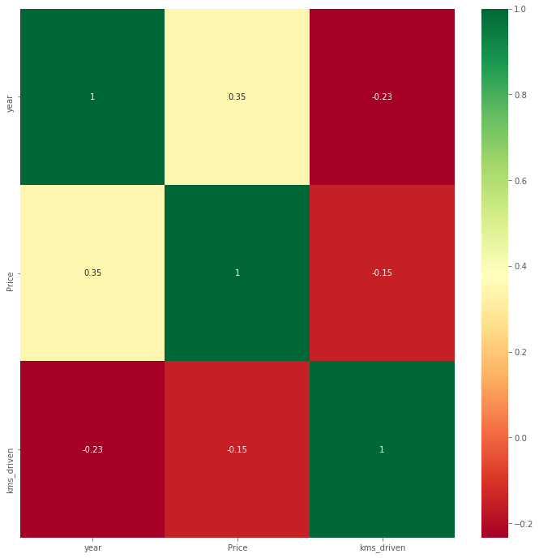
Car Price Prediction Model
Data Visualization
Heat Map

Slide 27
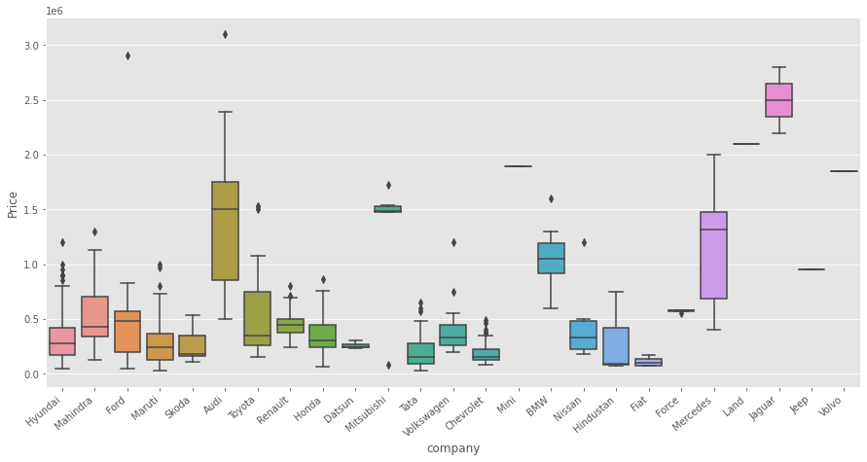
Car Price Prediction Model
Data Visualization
Checking relationship of Company with
Price

Slide 28
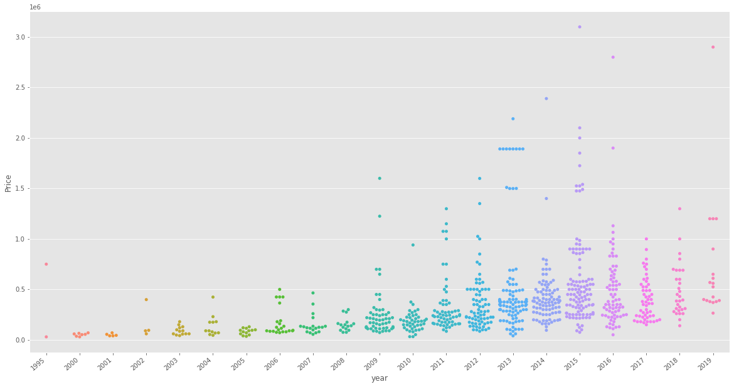
Car Price Prediction Model
Data Visualization
Checking relationship of Year with
Price

Slide 29
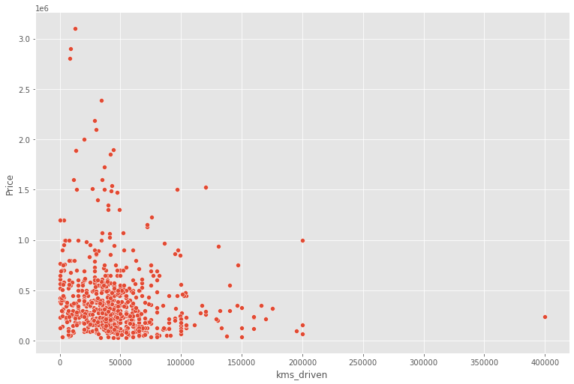
Car Price Prediction Model
Data Visualization
Checking relationship of kms_driven with
Price

Slide 30
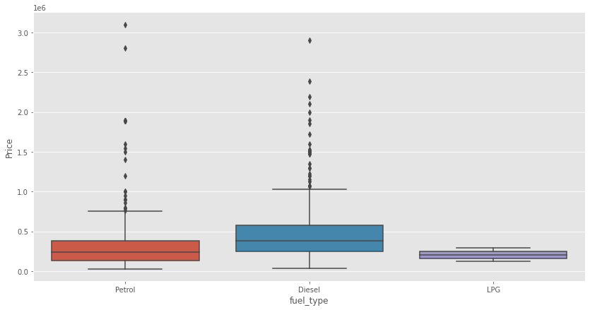
Car Price Prediction Model
Data Visualization
Checking relationship of Fuel Type with
Price

Slide 31
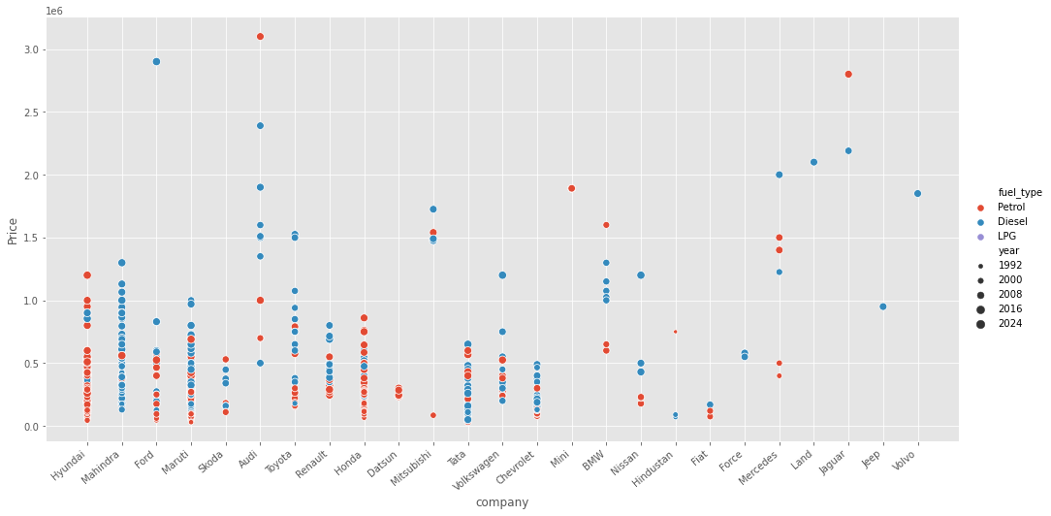
Car Price Prediction Model
Data Visualization
Relationship of Price with FuelType,
Year and Company mixed

Slide 32
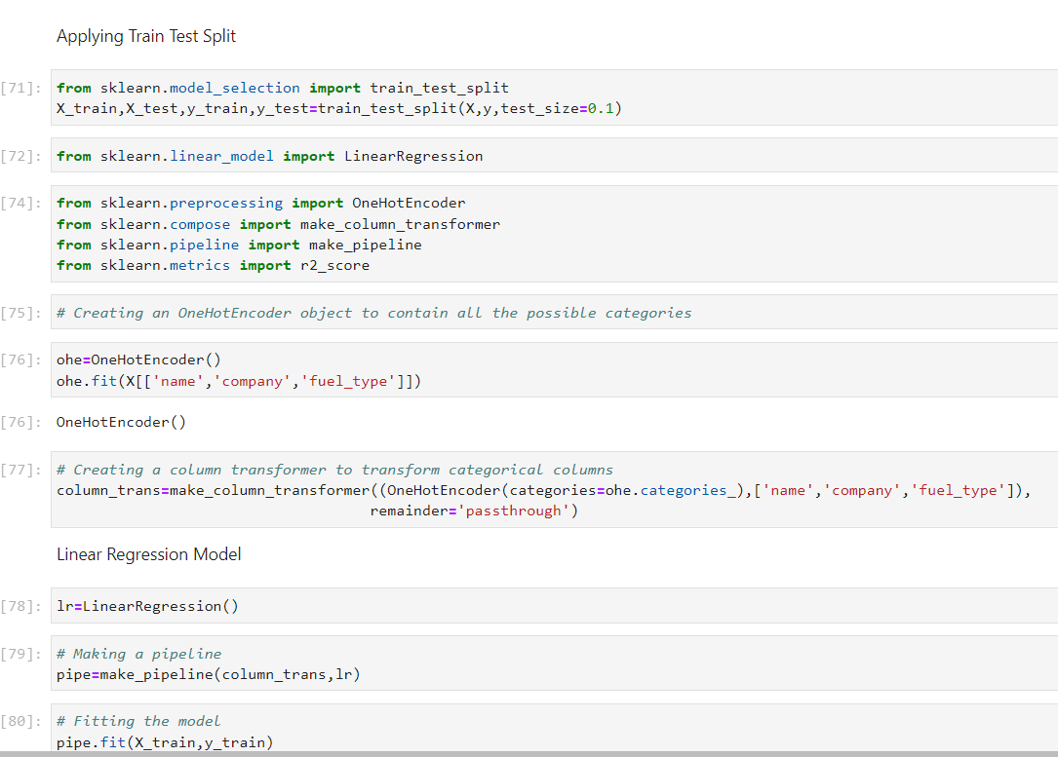
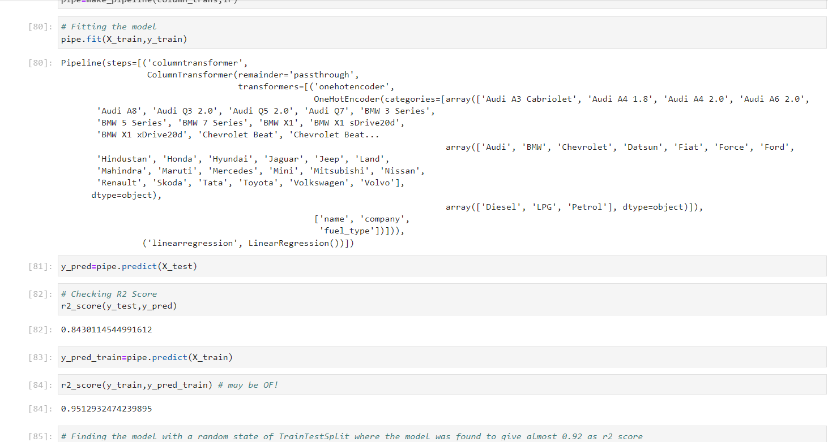
Car Price Prediction Model
Linear Regression

Slide 33
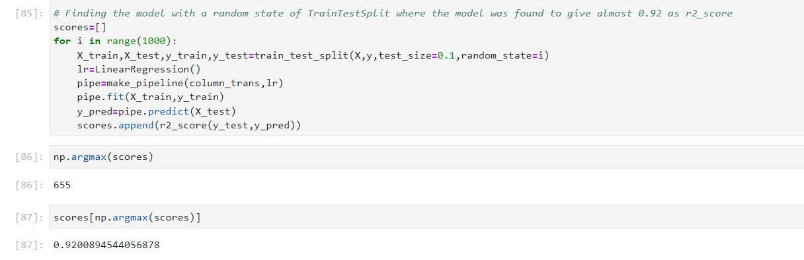
Car Price Prediction Model
Linear Regression
The R2 Score Obtained is 0.9200884

Slide 34
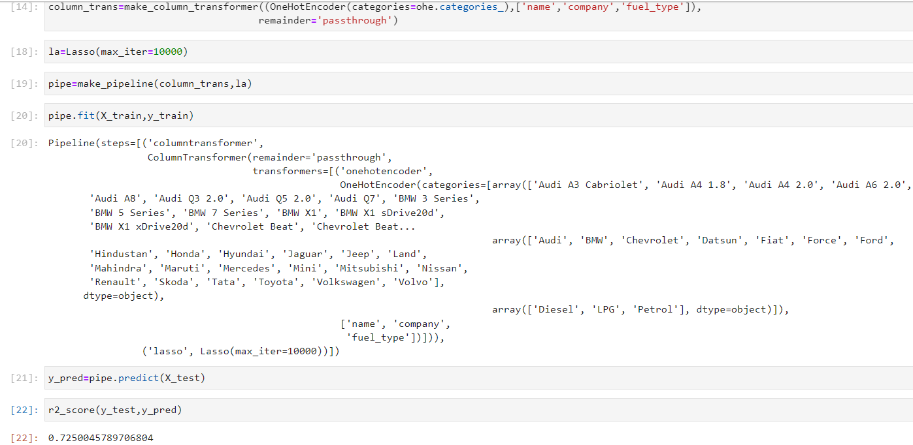
Car Price Prediction Model
Lasso Regression
The R2 Score Obtained is 0.7250045

Slide 35
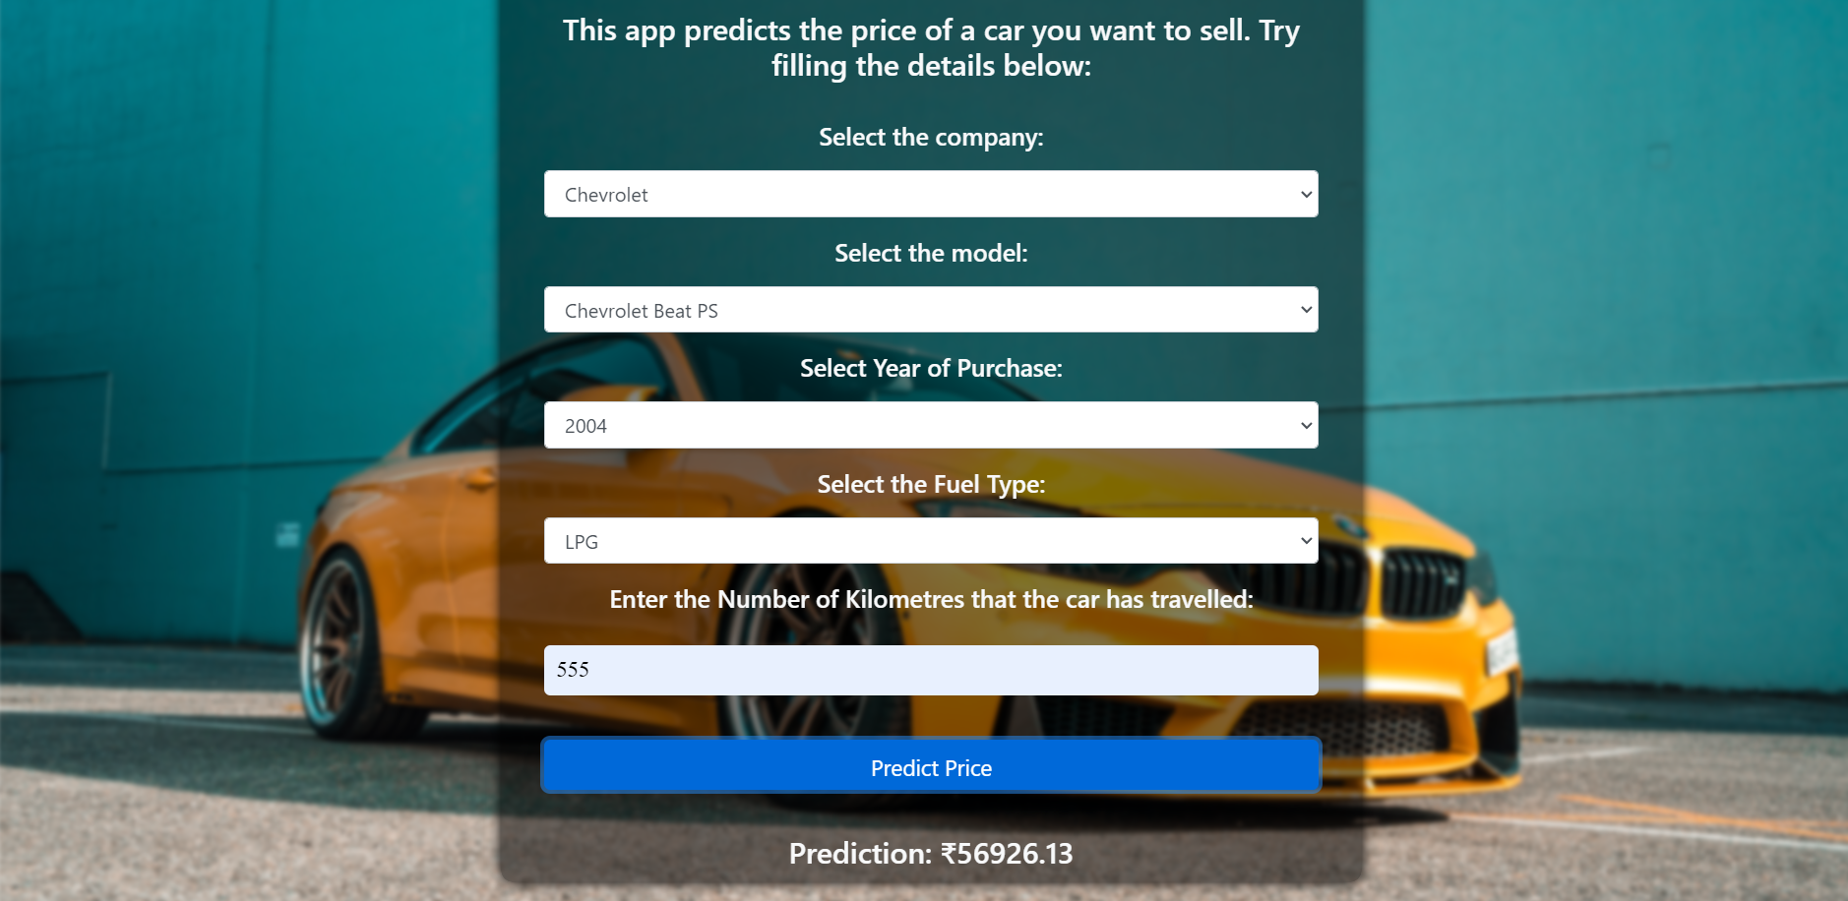
Car Price Prediction Model
GUI

Slide 36
House Price Prediction
Importing Dependencies and Checking Quality Of Data
House dataset is of Mumbai area uploaded by Sameep Seth under public domain license it contains information of houses all over the Mumbai such as area, location, number of bedrooms and various amenities available but our research focuses on the prices of house in Kharghar, Mira Road East and Thane West and we have considered features like area, location, number of bedrooms and whether a house is new or resale.

Slide 37
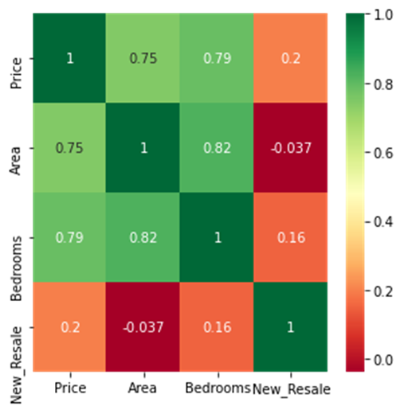
House Price Prediction
Data Visualization

Slide 38
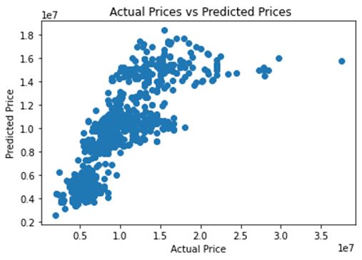

Implementation Implementing Linear and Ridge regression for House price prediction
Actual vs Predicted price by linear regression for training dataset of House price prediction
Actual vs Predicted price by Ridge regression for training dataset of House price prediction

Slide 39
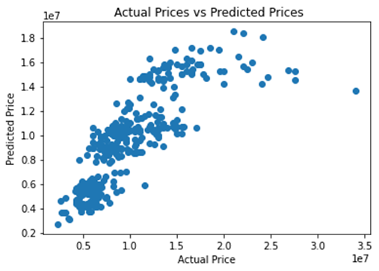

Implementation Implementing Linear and Ridge regression for House price prediction
Actual vs Predicted price by linear regression for test dataset of House price prediction
Actual vs Predicted price by Ridge regression for test dataset of House price prediction

Slide 40
Implementation Implementing Linear and Ridge regression for House price prediction
For the house price prediction model Linear and Ridge regression were studied here the dataset was divided into 70 percent for training data and 30 percent for test data.
For Linear regression a R2 score of 0.668408 was obtained for training dataset and a R2 score of 0.693642 was obtained for test dataset.
For Ridge regression a R2 score of 0.668403 was obtained for training dataset and a R 2 score of 0.693933 was obtained for test dataset.

Slide 41
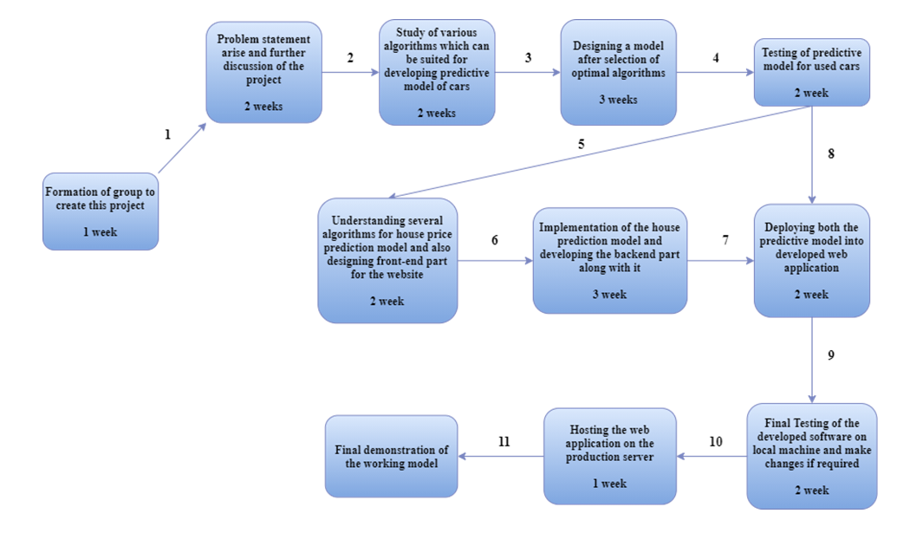
Pert Chart

Slide 42
Outcomes
SrNo | Course Outcomes | Pooruvi(GL) | Aditya | Omkar | Suraj
1 | Learner will be able to Identify societal/research/innovation/entrepreneurship problems through appropriate literature surveys | 5 | 5 | 5 | 5
2 | Identify Methodology for solving above problem and apply engineering knowledge and skills to solve it | 5 | 5 | 5 | 5
3 | Validate, Verify the results using test cases/benchmark data/theoretical/ inferences/experiments/simulations | 5 | 5 | 5 | 5
4 | Analyze and evaluate the impact of solution/product/research/innovation /entrepreneurship towards societal/environmental/sustainable development | 5 | 5 | 5 | 5
5 | Use standard norms of engineering practices and project management principles during project | 5 | 5 | 5 | 5
6 | communicate through technical report writing and oral presentation. | 5 | 5 | 5 | 5
7 | Gain technical competency towards participation in Competitions, Hackathons, etc. | 5 | 5 | 5 | 5
8 | Demonstrate capabilities of self-learning, leading to lifelong learning. | 5 | 5 | 5 | 5
9 | Develop interpersonal skills to work as a member of a group or as leader | 5 | 5 | 5 | 5
 |  | 5 | 5 | 5 | 5

Slide 43
CONCLUSION:
A car and House price prediction system has been proposed Which helps user's to evaluate the best resale value of their cars and value of their housing properties considering number of factors providing users with assurance and transparency

Slide 44
References
https://towardsdatascience.com/predicting-house-prices-with-linear-regression-machine-learning-from-scratch-part-ii-47a0238aeac1
https://www.sciencedirect.com/science/article/pii/S1877050920316318
https://www.ijert.org/real-estate-price-prediction
https://www.analyticsvidhya.com/blog/2021/07/car-price-prediction-machine-learning-vs-deep-learning/
https://towardsdatascience.com/predicting-car-price-using-machine-learning-8d2df3898f16
https://www.irjet.net/archives/V8/i4/IRJET-V8I4278.pdf
https://www.turcomat.org/index.php/turkbilmat/article/download/6435/5333
https://www.researchgate.net/publication/344099603_Employing_Machine_Learning_for_House_Price_Prediction

Slide 45
Thank You!!!

